Slide 1
Survival Analysis With K-M Curves/Estimates
Presenter: KAKANDE Paul, MPS

Slide 2
Scope
Definition of Survival Analysis.
Survival Analysis with K-M Curves and Estimates.
Calculation and Interpretation of K-M Curves/Estimates.
Survival Analysis in Cancer – Focus on Python Programming Language.

Slide 3
Introduction
Sample Questions:
How can incomplete observations (clinical trials, structural integrity studies, …) be interpreted?
Could we predict undesirable incidences prior to their occurrence (mortality, machine breakdown, …) given prior knowledge?

Slide 4
Introduction
Edward L. Kaplan and Paul Meier published a seminal paper in 1958 to provide workarounds such questions.
These survival curves and estimates have been employed in different sectors other than medicine.
With these, ‘survival’ does not necessarily indicate ‘death’ but an ‘event’ or ‘endpoint’ of interest.

Slide 5
Key Concepts
Survival time / Time-to-event
Event
Censoring
Survival Probability
Hazard Ratio

Slide 6
Censoring
Time-to-event may not be accurately determined.
Right Censoring – Event is beyond end of follow-up period.
Left Censoring – Event cannot be observed. It could have occurred earlier before the experiment.
Interval Censoring – Data available for some intervals

Slide 7
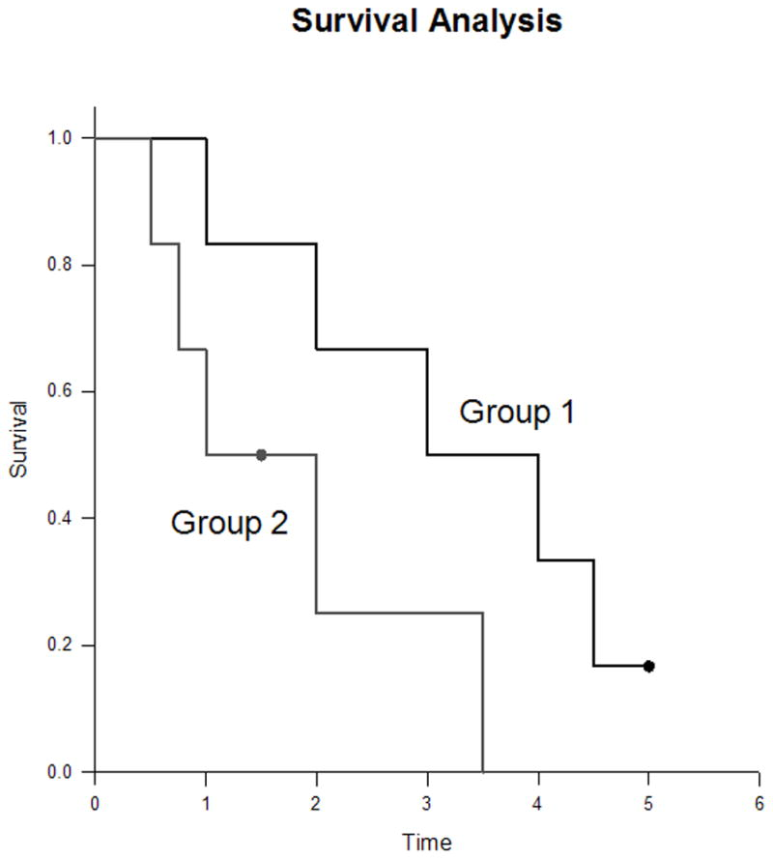
Survival Analysis – With K-M Curves
Censored subjects are represented by dots.
Horizontal lines represent Interval Survival duration.
Vertical lines are for aesthetics.

Slide 8
Considerations of K-M Curves
The survival curve becomes an estimate after the censoring of the first patient.
Reason for censoring is important in curve interpretation.
Estimates at the far right of the curve should be interpreted with caution.

Slide 9
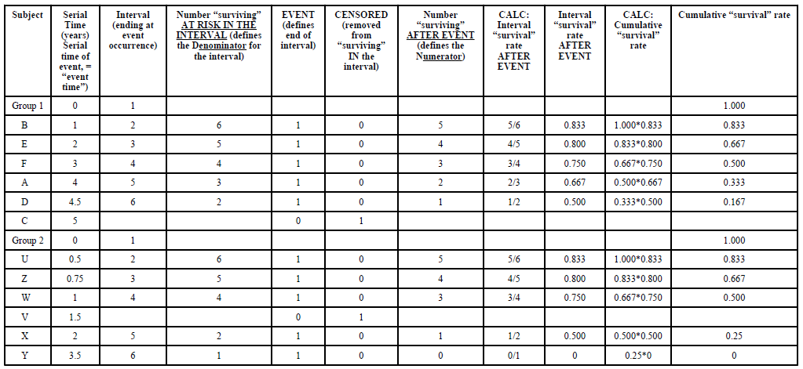
Survival Calculations

Slide 10
Interpretation of K-M Curves
Interpret as a whole – not parts.
Two curves are compared statistically - log-rank test and Cox proportion hazard test.
Confidence Intervals may be employed.

Slide 11
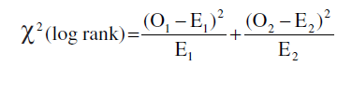
log rank test
O1 – Observed events in group 1
E1 – Expected events in group 1
O2 – Observed events in group 2
E2 – Expected events in group 2

Slide 12
Survival Analysis in Cancer – With Python
Available Packages:
scikit-survival
lifelines

Slide 13
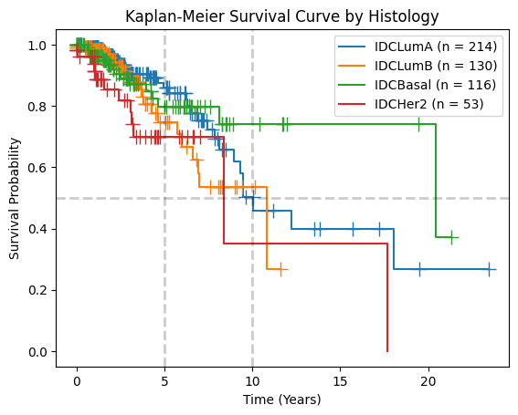
Survival Analysis – Breast Cancer

Slide 14
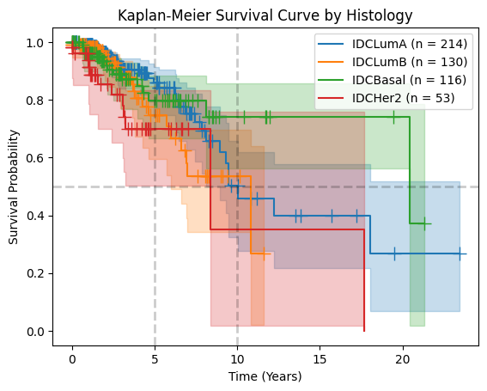
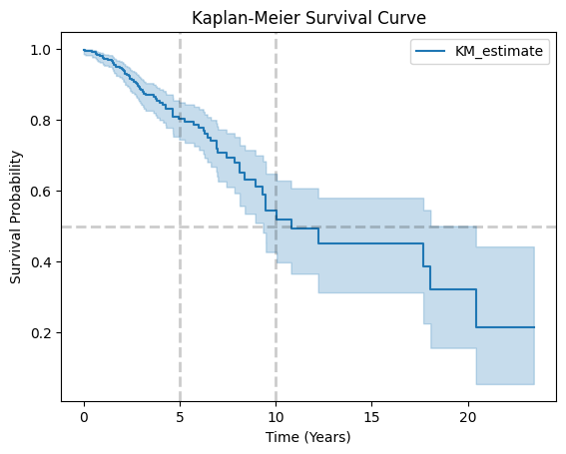
Survival Analysis – Breast Cancer
Separate by Histology
Combined

Slide 15
References
Rich, J. T., Neely, J. G., Paniello, R. C., Voelker, C. C., Nussenbaum, B., & Wang, E. W. (2010). A practical guide to understanding Kaplan-Meier curves. Otolaryngology--head and neck surgery : official journal of American Academy of Otolaryngology-Head and Neck Surgery, 143(3), 331–336. https://doi.org/10.1016/j.otohns.2010.05.007
Goel, M. K., Khanna, P., & Kishore, J. (2010). Understanding survival analysis: Kaplan-Meier estimate. International journal of Ayurveda research, 1(4), 274–278. https://doi.org/10.4103/0974-7788.76794
Clark TG, Bradburn MJ, Love SB, Altman DG. Survival analysis part I: basic concepts and first analyses. Br J Cancer. 2003 Jul 21;89(2):232-8. doi: 10.1038/sj.bjc.6601118. PMID: 12865907; PMCID: PMC2394262.

Slide 16
References
Deo SV, Deo V, Sundaram V. Survival analysis-part 2: Cox proportional hazards model. Indian J Thorac Cardiovasc Surg. 2021 Mar;37(2):229-233. doi: 10.1007/s12055-020-01108-7. Epub 2021 Jan 2. PMID: 33642726; PMCID: PMC7876211.
Bradburn MJ, Clark TG, Love SB, Altman DG. Survival analysis Part III: multivariate data analysis -- choosing a model and assessing its adequacy and fit. Br J Cancer. 2003 Aug 18;89(4):605-11. doi: 10.1038/sj.bjc.6601120. PMID: 12915864; PMCID: PMC2376927.
Clark TG, Bradburn MJ, Love SB, Altman DG. Survival analysis part IV: further concepts and methods in survival analysis. Br J Cancer. 2003 Sep 1;89(5):781-6. doi: 10.1038/sj.bjc.6601117. PMID: 12942105; PMCID: PMC2394469.

Slide 17
References
https://www.kdnuggets.com/2020/07/complete-guide-survival-analysis-python-part1.html
https://www.databricks.com/notebooks/telco-accel/02_kaplan_meier.html
Sebastian PÃlsterl, scikit-survival: A Library for Time-to-Event Analysis Built on Top of scikit-learn, Journal of Machine Learning Research, 2020, 21, 212, 1—6, http://jmlr.org/papers/v21/20-729.html
Bewick, V., Cheek, L., & Ball, J. (2004). Statistics review 12: survival analysis. Critical care (London, England), 8(5), 389–394. https://doi.org/10.1186/cc2955

Slide 18
Thank You

